Slide 1

Getting to Know the Random Class in Python
Presentation created by Tristan Beckmann
CS-150 / Sarkar
4-23-23

Slide 2
What is the Random Class?
The Random class is a built-in module in Python that allows you to generate random numbers.
It is used to generate random numbers, randomize sequences, and generate random selections from lists.
The significance of the Random class in Python programming is that it is used when we need some element of randomness in our program.
It is widely used in game development, simulation, data analysis, and more.
With Random class, you can generate random numbers, create random shuffles of sequences, choose random elements from a list, and more.

Slide 3
The Purpose of the Random Class
The main purpose of the Random Class in generating random numbers in Python is to provide a way to generate random numbers that can be used in various applications.
The random numbers generated by the Random Class are not truly random but are instead generated using a pseudorandom number generator.
This means that the numbers are not truly random but are generated in such a way that they appear to be random.
The class provides a range of methods that allow you to generate random integers, floating-point numbers, and random selections from a sequence or list.

Slide 4
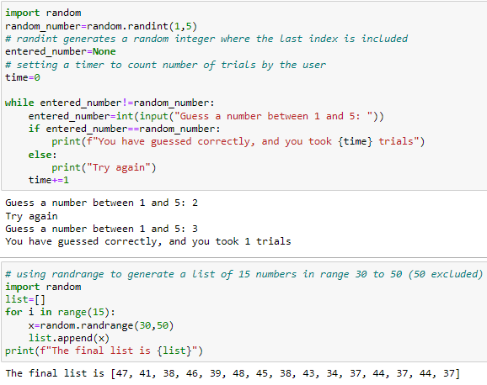
Different ways to use the Random Class

Slide 5
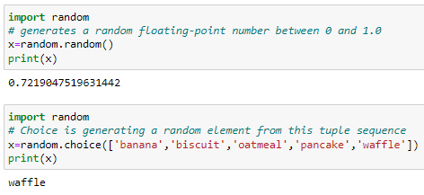
Different ways to use the Random Class

Slide 6
Practical applications of the Random Class
These methods can be used in various scenarios, such as game development, simulation, data analysis, and more.
For example, randint() can be used to generate a random number for a game.
randrange() can be used to generate a random number for a simulation.
random() can be used to generate random decimal numbers for data analysis.
choice() can be used to select a random item from a list in a program.

